Slide 1
HACK.OUT
By Diego Prado, Gerard Nelson, Richard LeBell, Jacob Ryans

Slide 2
OVERVIEW
Our Final Pi Project consists of a 2D game called Hack.out. It involves a player who must figure out how to escape the building.
We used the GPIO pins to control movement of the player and keep track of health. We also used Pygame to work as the game engine and Tkinter to create the windows.
We found it to be relevant due to using the techniques acquired from the freshman 130 Computer Science series.

Slide 3
MATERIALS
Objects
Breadboard extended
Raspberry pi 3 model B
22 Gauge wire
Red LEDs
Pi Cobbler GPIO pins
Buttons
Important Libraries
Tkinter
Pygame

Slide 4
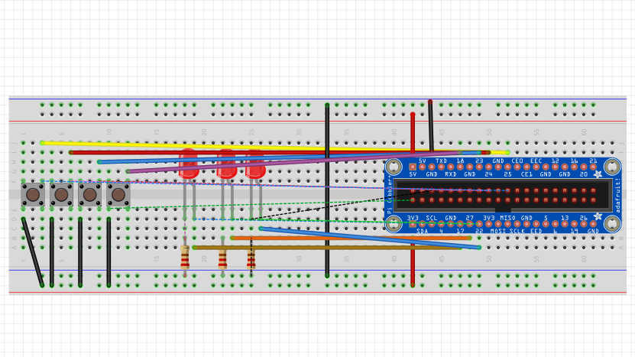
CIRCUIT DIAGRAM

Slide 5
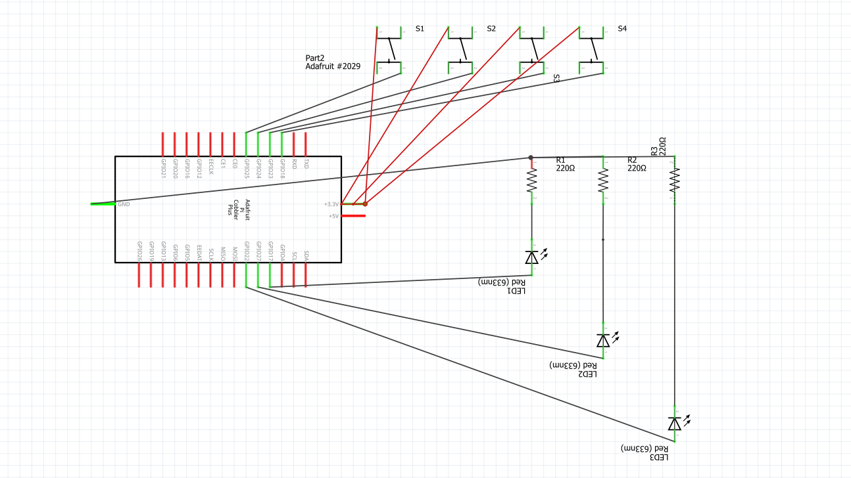
LAYOUT DIAGRAM

Slide 6

DEMONSTRATION

Slide 7
OLD AND NEW TARGETS
Old targets involved creating a 3x3 room consisting of 3 floors. Use the labs to track heath in each room. Solve word by in each room. Use buttons on the breadboard to move the person in each room.
New targets include creating a single 3x3 floor to escape from with more detail to items and area.

Slide 8
FUTURE DEVELOPMENT
Future development of our project could include making the person jump and talk to new characters, add a combat system to fight enemies and also include a map of the building.
We learned how to work as a team, how to code games using pygame, move objects, and keep track of life.

Slide 9

Issues
The game would never start on the raspberry pi but pushed no errors to help figure out the solution.
We had a difficult time creating map generation in the beginning stages of our project.

Slide 10
Reflection
Overall, the project went pretty smoothly but things we could have improved on would be better team management and time management.
We ended up taking on a lot more than we could handle, causing the program to feel incomplete.

Slide 11
Link to Github
https://github.com/renegade27/Final-Pi-Project

